Slide 1
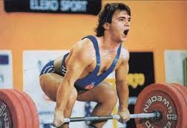
“THE POCKET HERCULE”
THE TURKISH HERO FOREVER
NAİM SÜLEYMANOĞLU

Slide 2
Naim Süleymanoğlu
Full name: Naim Süleymanoğlu Other name(s): Naim Suleimanov, Naum Shalamonov, Наим Сюлейманов, Наум Шаламанов Nickname(s): The Pocket Hercules Gender: Male Height: 4'11" (150 cm) Weight: 60-64 kg Born: January 23, 1967 (Age 46) in Ptichar, Kardzhali, Bulgaria Country: Turkey Sport: Weightlifting
Medals: 3 Gold (3 Total)

Slide 3
is likely that Naim Süleymanoğlu is the strongest man who has ever lived, pound-for-pound. Nicknamed “The Pocket Hercules”

Slide 4
He first came to international acclaim at age 14 at the World Junior Championships in São Paulo. He set his first world record at age 15, and at the 1984 European Championships he became the second man (after Bulgaria's Stefan Topurov) to lift three times bodyweight overhead.

Slide 5
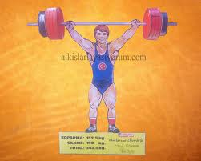
Süleymanoğlu was also the first man to snatch 2½ times his own bodyweight (27 April 1988). Prior to the 1988 Olympics, he had set 32 world records before he was 22 years old.

Slide 6
He was born in Bulgaria and represented them until he defected to Turkey at the 1986 World Cup finals.

Slide 7
Süleymanoğlu was World Champion at 60 kg. in 1985, 1986, 1989, and 1991 and European Champion in 1984, 1985, 1986 and 1988.

Slide 8
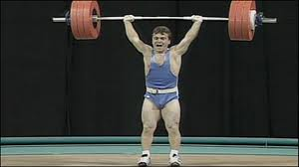
In 1992 at Barcelona, he defended his Olympic championship despite his recent retirement, and he won his third Olympic gold medal in 1996 at Atlanta. He also competed at Sydney in 2000 but failed to medal.

Slide 9
HE IS MY POCKET HERO ☺

